Slide 1
Introduction of Bylinghua
MORE

Slide 2
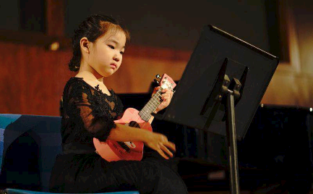
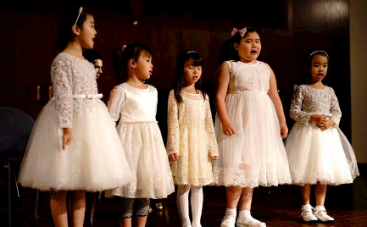
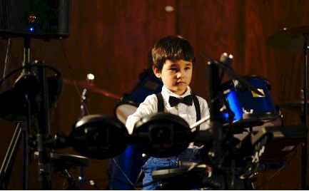
ABOUT US
Bylinghua is a comprehensive school integrating music teaching, culture and art education and media advertising.
Since its establishment in 2013, Bylinghua has been committed to building a bridge between Chinese and Western culture through music so as to promote understanding, recognition and ownership of traditional Chinese music culture among Chinese-Americans and their descendants.
In the beginning, the school was mainly engaged in music teaching, musical instrument sales as well as music software research and development, and then it gradually expanded its business to various courses involving Chinese, robotics, dance and art. To closely follow the trend of the times,Bylinghua also expands its influence and enhances its brand value by the virtue of public accounts and live broadcast platforms. Our teaching team is composed of professional teachers with rich teaching experience, guaranteeing that we can meet various needs of different parents.
MORE

Slide 3
CONTENTS
01.
02.
03.
04.
Business
Music
Education
Media

Slide 4
2022
MORE
01.
Main engagement

Slide 5
Main engagement
Bylinghua Music
Bylinghua Education
Bylinghua Media
Music education
Musical instruments sales
Music applications
Chinese courses
Robots
Art
Special children
Public accounts
Live broadcast platforms
Piano
Drums
Ukelele
Guitar
Vocal music
Guzheng
Erhu

Slide 6
History of Bylinghua
Comprehensive music school of Bylinghua
Bylinghua Musical Instrument Store
music studio
Online Bylinghua Education
Bylinghua Education
Piano
Violin
Chinese music
Vocal music
Courses involving Chinese, robots, art for children
Shift to online education under the influence of the covid-19
Instrument sales
2013
2018
2020~
2017
2019

Slide 7
2022
MORE
02.
Bylinghua Music

Slide 8
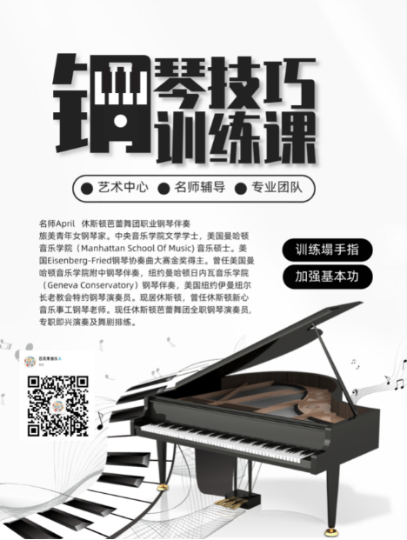
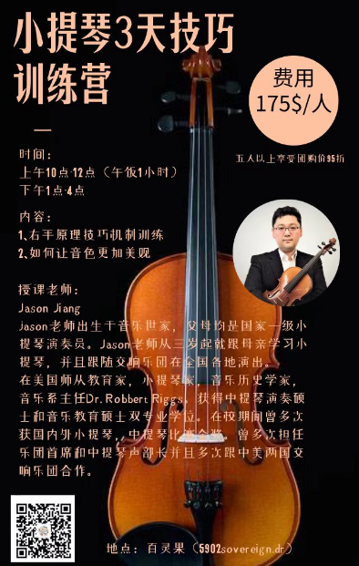
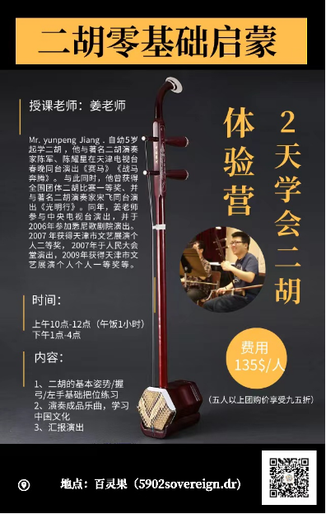
1、Music Courses
​
Piano
Violin
Ukelele
Drums
Folk music
Music theory
Piano Violin Erhu
钢琴
小提琴
二胡

Slide 9
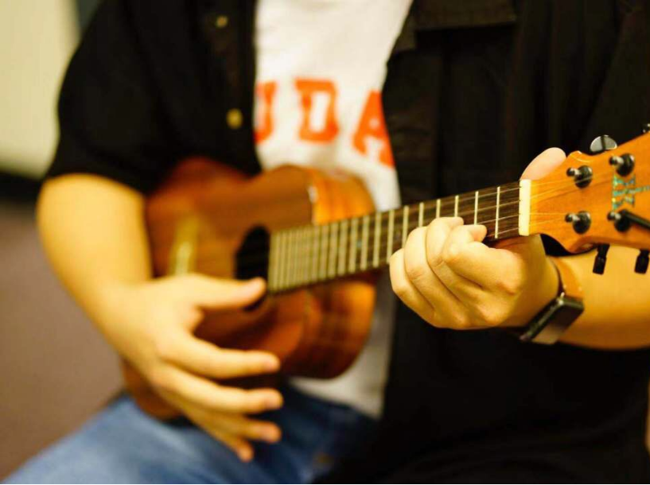
1、Music Courses​
Piano
Violin
Ukelele
Drums
Folk music
Music theory
Piano Violin Erhu
Chinese music
Ukelele

Slide 10
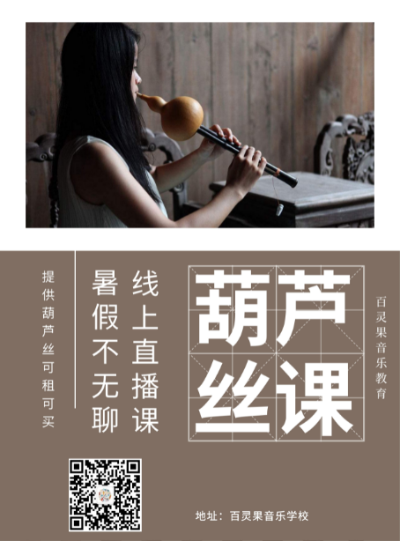
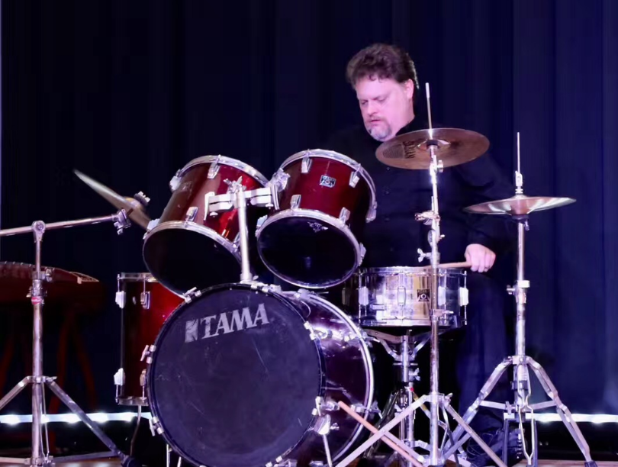
1、Music Courses​
Piano
Violin
Ukelele
Drums
Folk music
Music theory
Piano Violin Erhu
Hulusi
Drum

Slide 11
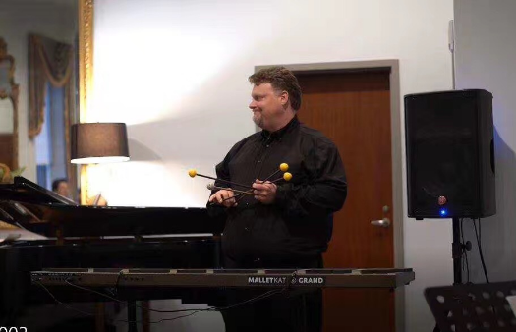
2、Special projects
Chinese drum band
Children rock band
Traditional Chinese music band
​
Chinese Drum Band and Rock Band were set up in 2021. Clark, leader of Chinese Drum Band and Rock Band, who was a former Houston public School band director, has more than 20 years of experience in conducting and teaching bands, especially percussion and strumming. With rich experience in both performance and teaching, he has been the National Marimba solo champion for three consecutive years. Elizabeth, leader of Bylinghua chorus was led by Elizabeth, under whose leadership the team has been the city champion for two consecutive years.
As part of the most important content of Montgomery project, to set up bands is a newly launched advanced program of Bylinghua. Through setting up different types of bands, this high-end program aims to discover students with musical talent, and to provide more opportunities for them to perform on the stage, thus constantly enhancing their musical perception and ability to perform.

Slide 12
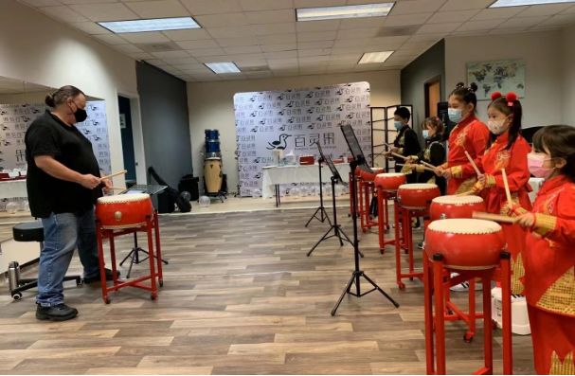
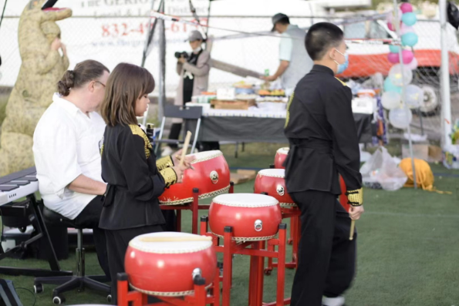
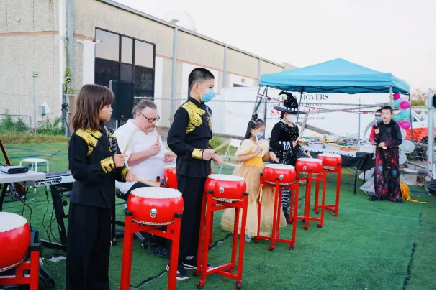
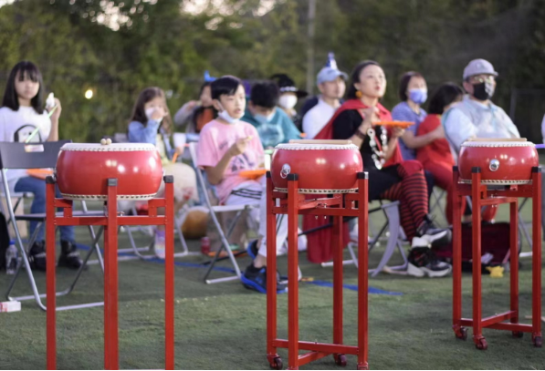
2、Special projects​
Chinese drum band
Children rock band
Traditional Chinese music band
Chinese drum band

Slide 13
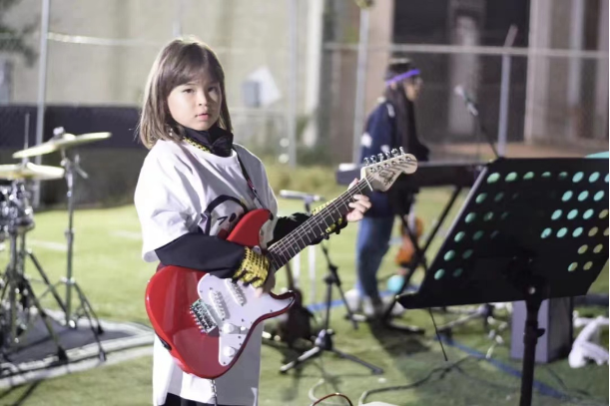
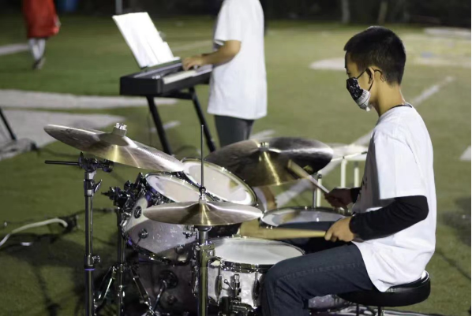
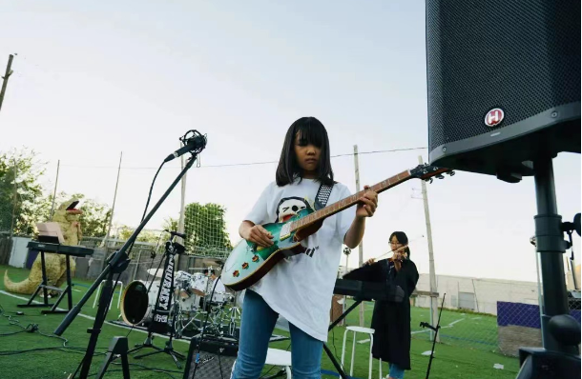
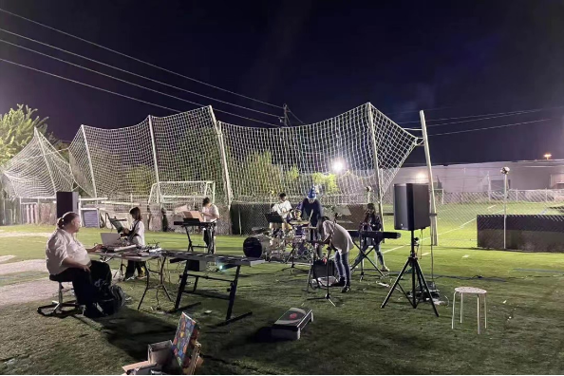
2、Special projects
Chinese drum band
Children rock band
Traditional Chinese music band
Rock Band

Slide 14
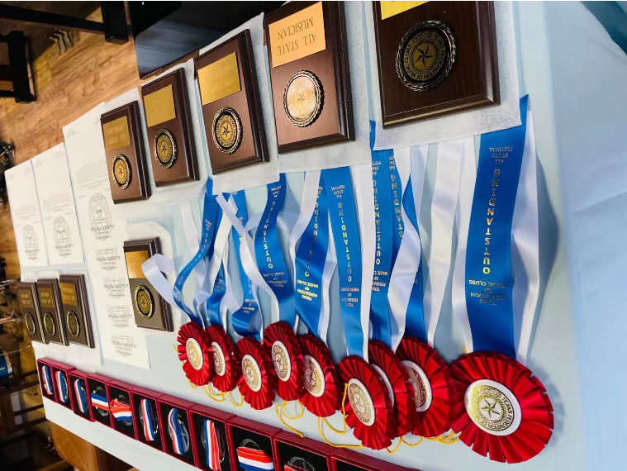
3.Excellent Performance of Students
All State Passing rate--99%
Win awards in international competitions such as Water Cube
ALL STATE

Slide 15
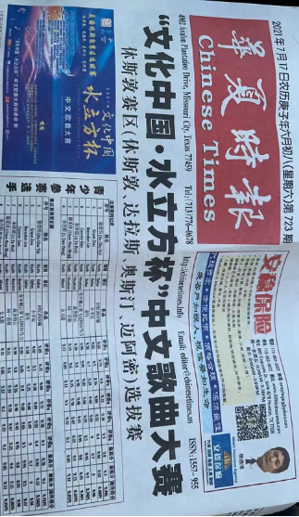
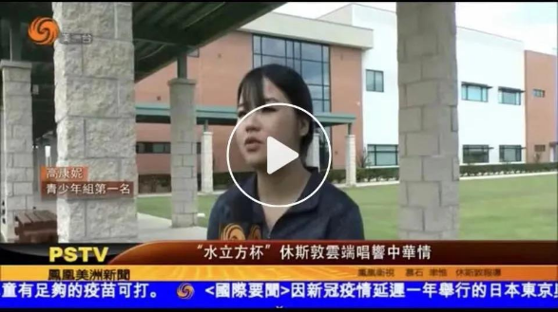
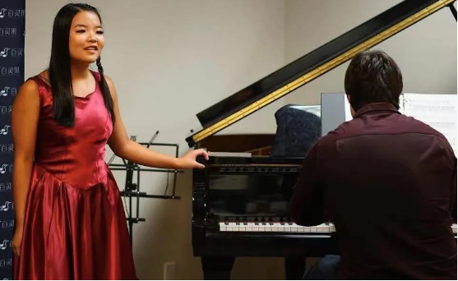
3、Excellent Performance of Students
All State Passing rate--99%
Win awards in international competitions such as Water Cube
Champion of Water Cube Youth Group
The Houston audition of "Culture of China Water Cube Cup" Chinese song Contest was held recently. "Lark Flies over Alamalee" by Lark Student Connie Gao won the junior division with honor.

Slide 16
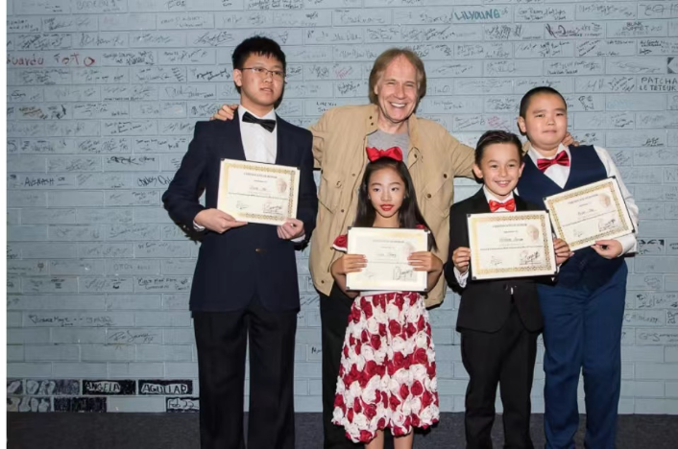
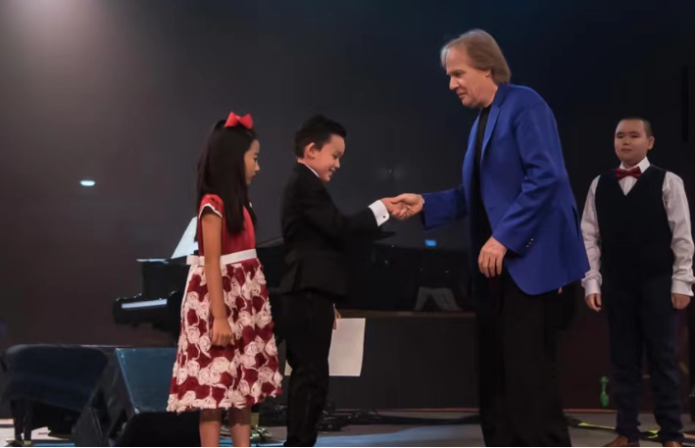
3、Excellent Performance of Students
All State Passing rate--99%
Win awards in international competitions such as Water Cube
On stage with Kleinman

Slide 17
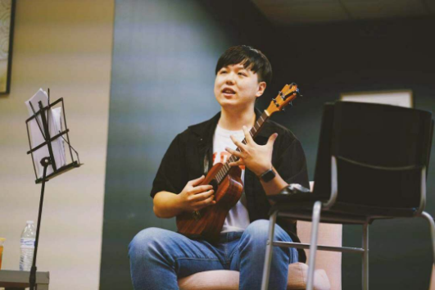
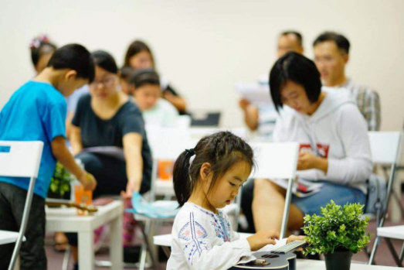
4.Special Activities
Charity lectures
Music competition
Concerts
Guitar lectures

Slide 18
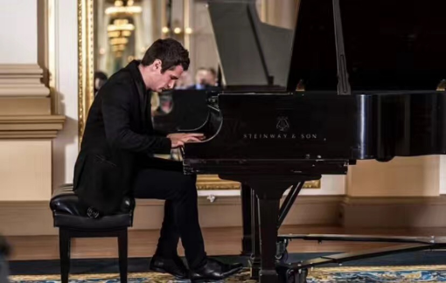
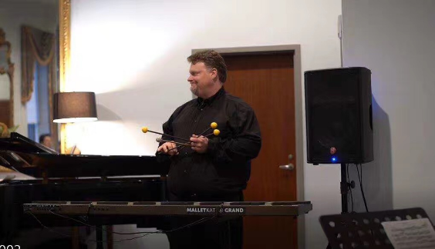
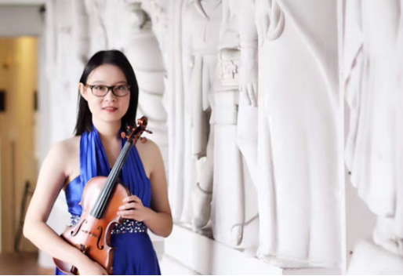
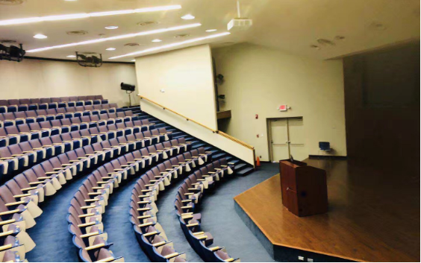
18.Bylinghua Master Lectures
Place:Bylinghua Technology and Music School
Content:answers to questions involving the violin, piano and percussion music

Slide 19
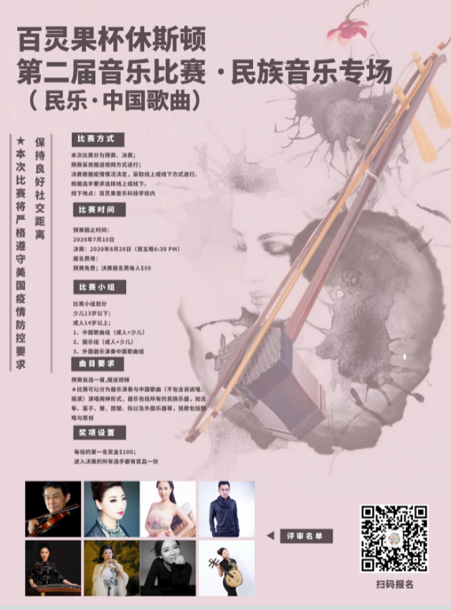
Music competition
The first professional comprehensive music competition of Bylinghua
The second music competition--Special performance of folk music

Slide 20
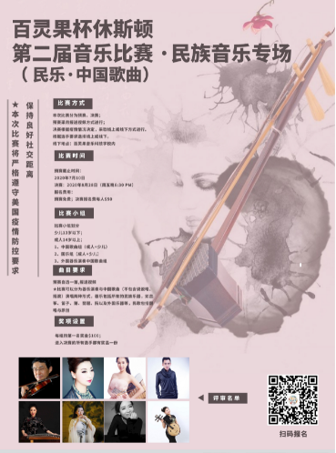
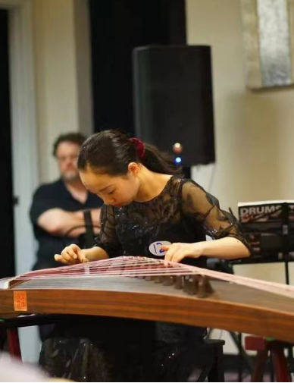
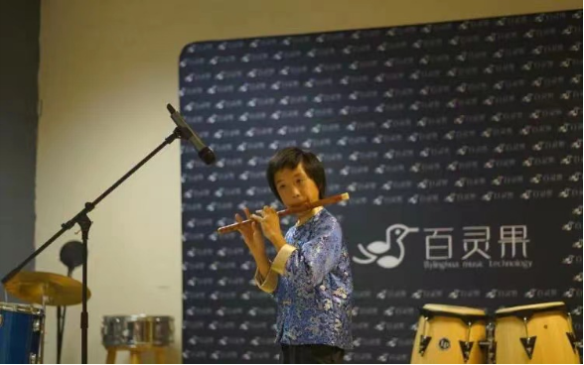
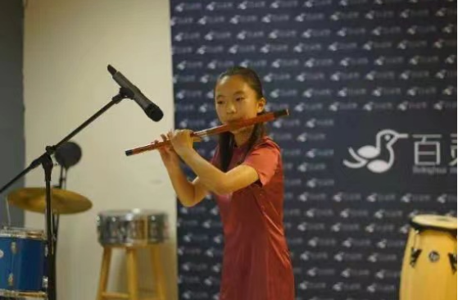
Music competition
The first professional comprehensive music competition of Bylinghua
The second music competition--Special performance of folk music

Slide 21
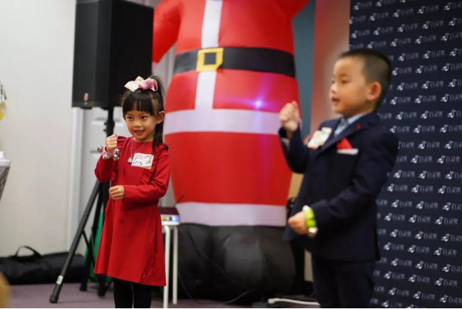
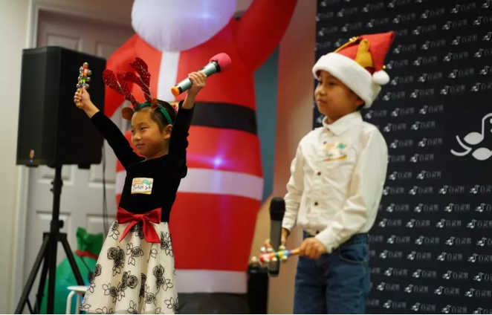
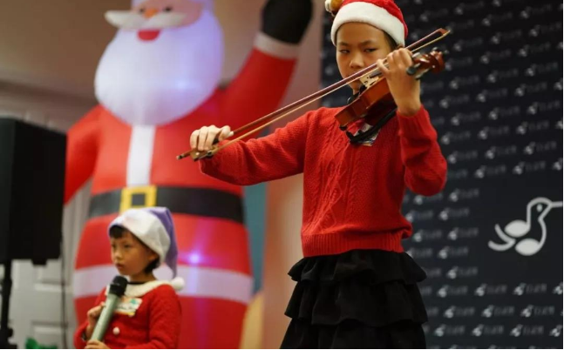
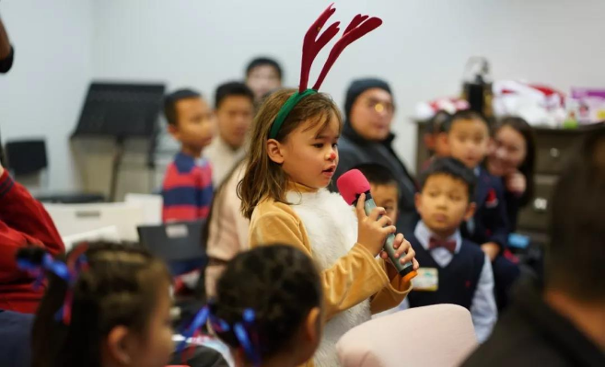
21.Music competition
Christmas songs competition

Slide 22
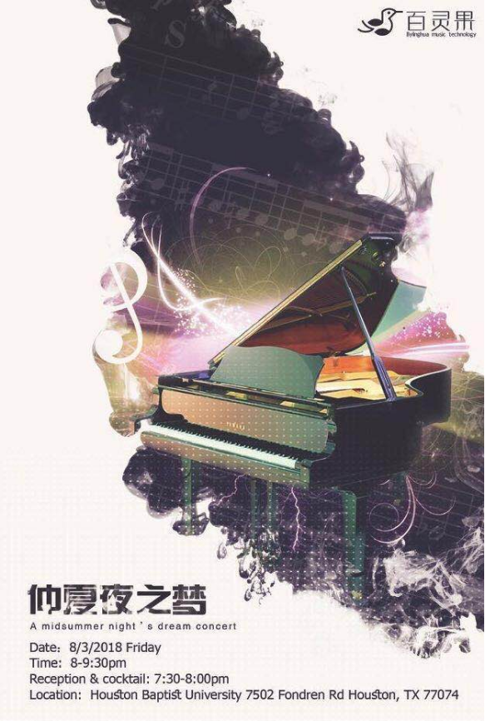
Concerts and Salon
Bylinghua Music Technology has always been committed to creating high-end concerts, and this concert in the retro elegant auditorium, invites VIP guests and music enthusiasts to review classical music, edify sentiment and exchange feelings in the accompany of delicacies.
The performers at the music Salon are all excellent teachers and invited guests from Bylinghua Music School. Full of passion for art and music and with high artistic attains in music, they developed superb performance skills, innovates diverse music ideas and performs in flexible forms, all of them gaining them much popularity among the public.

Slide 23
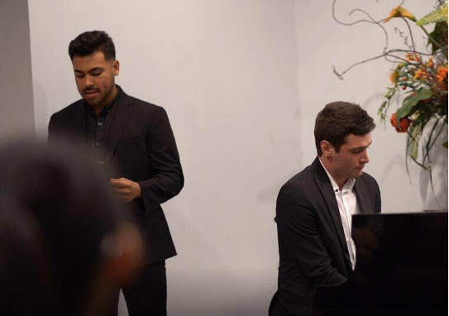
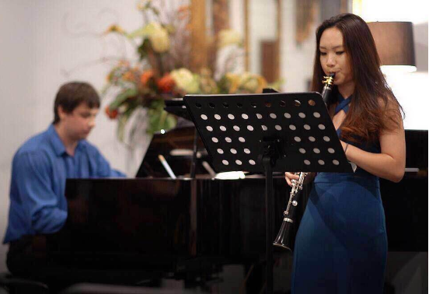
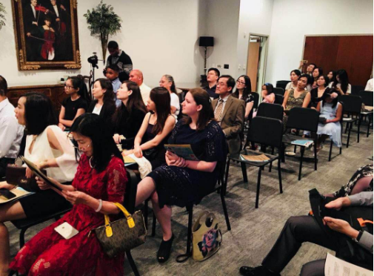
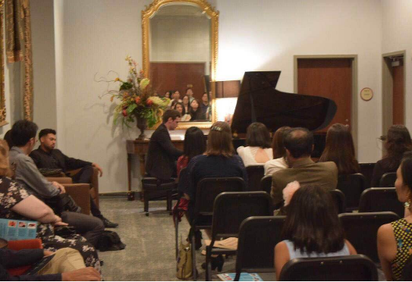
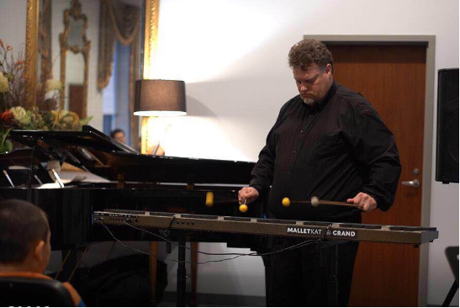
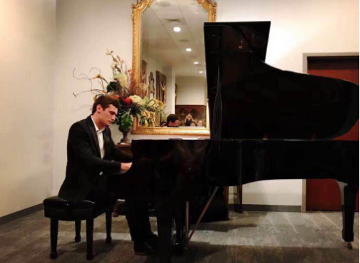

Slide 24
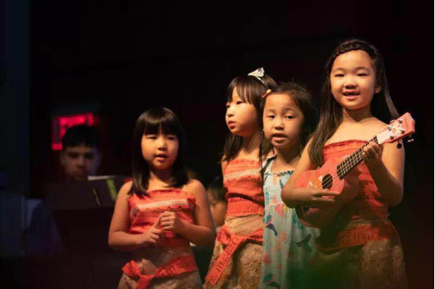
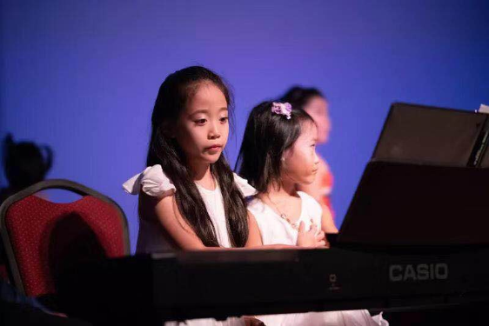
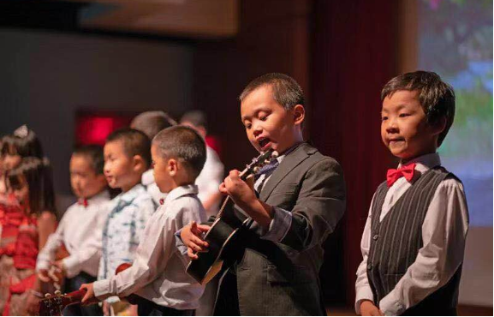
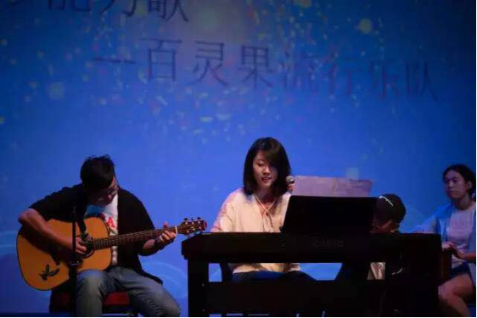
24.Mid autumn gala
Place: Houston University, Lace University

Slide 25
Mid autumn gala

Slide 26
Pearland Talents show

Slide 27
Pearland Talents show

Slide 28
2022
MORE
03.
Bylinghua Education

Slide 29
The curriculum

Slide 30
The curriculum

Slide 31
2022
MORE
04.
Bylinghua Media

Slide 32
Public accounts of Bylinghua
Houston Bylinghua Education
Houston Austin Sis’talk
Montgomery's top music label

Slide 33
We-media of Bylinghua

Slide 34
THANK
YOU
Thank you for listening
Looking forward to hearing your voice.
END

